Slide 1

SULPHUR PRICE PREDICTION
By : Sangita Bhalothia
Nov 23 – Mar 24

Slide 2

PROBLEM DEFINITION

Slide 3

Sulphur stands as a cornerstone raw material within Agrocel Industry's chemical compound manufacturing processes. As any alteration in its production directly impacts on our outcomes. Hence, meticulous monitoring and comprehension of how fluctuations in its price or demand influence our operations are imperative. It is essential to explore if predictive methodologies exist to anticipate such shifts, enabling proactive decision-making.

Slide 4
EXPECTED
OUTCOME

Slide 5
Analysis of market dynamics to gain comprehensive insights of trends and seasonality involved in price or demand can help to mitigate the potential risks associated with the market volatility.
Accurate forecasting enables proactive decision-making regarding procurement, production planning, and pricing strategies, leading to optimized resource allocation and cost savings.

Slide 6
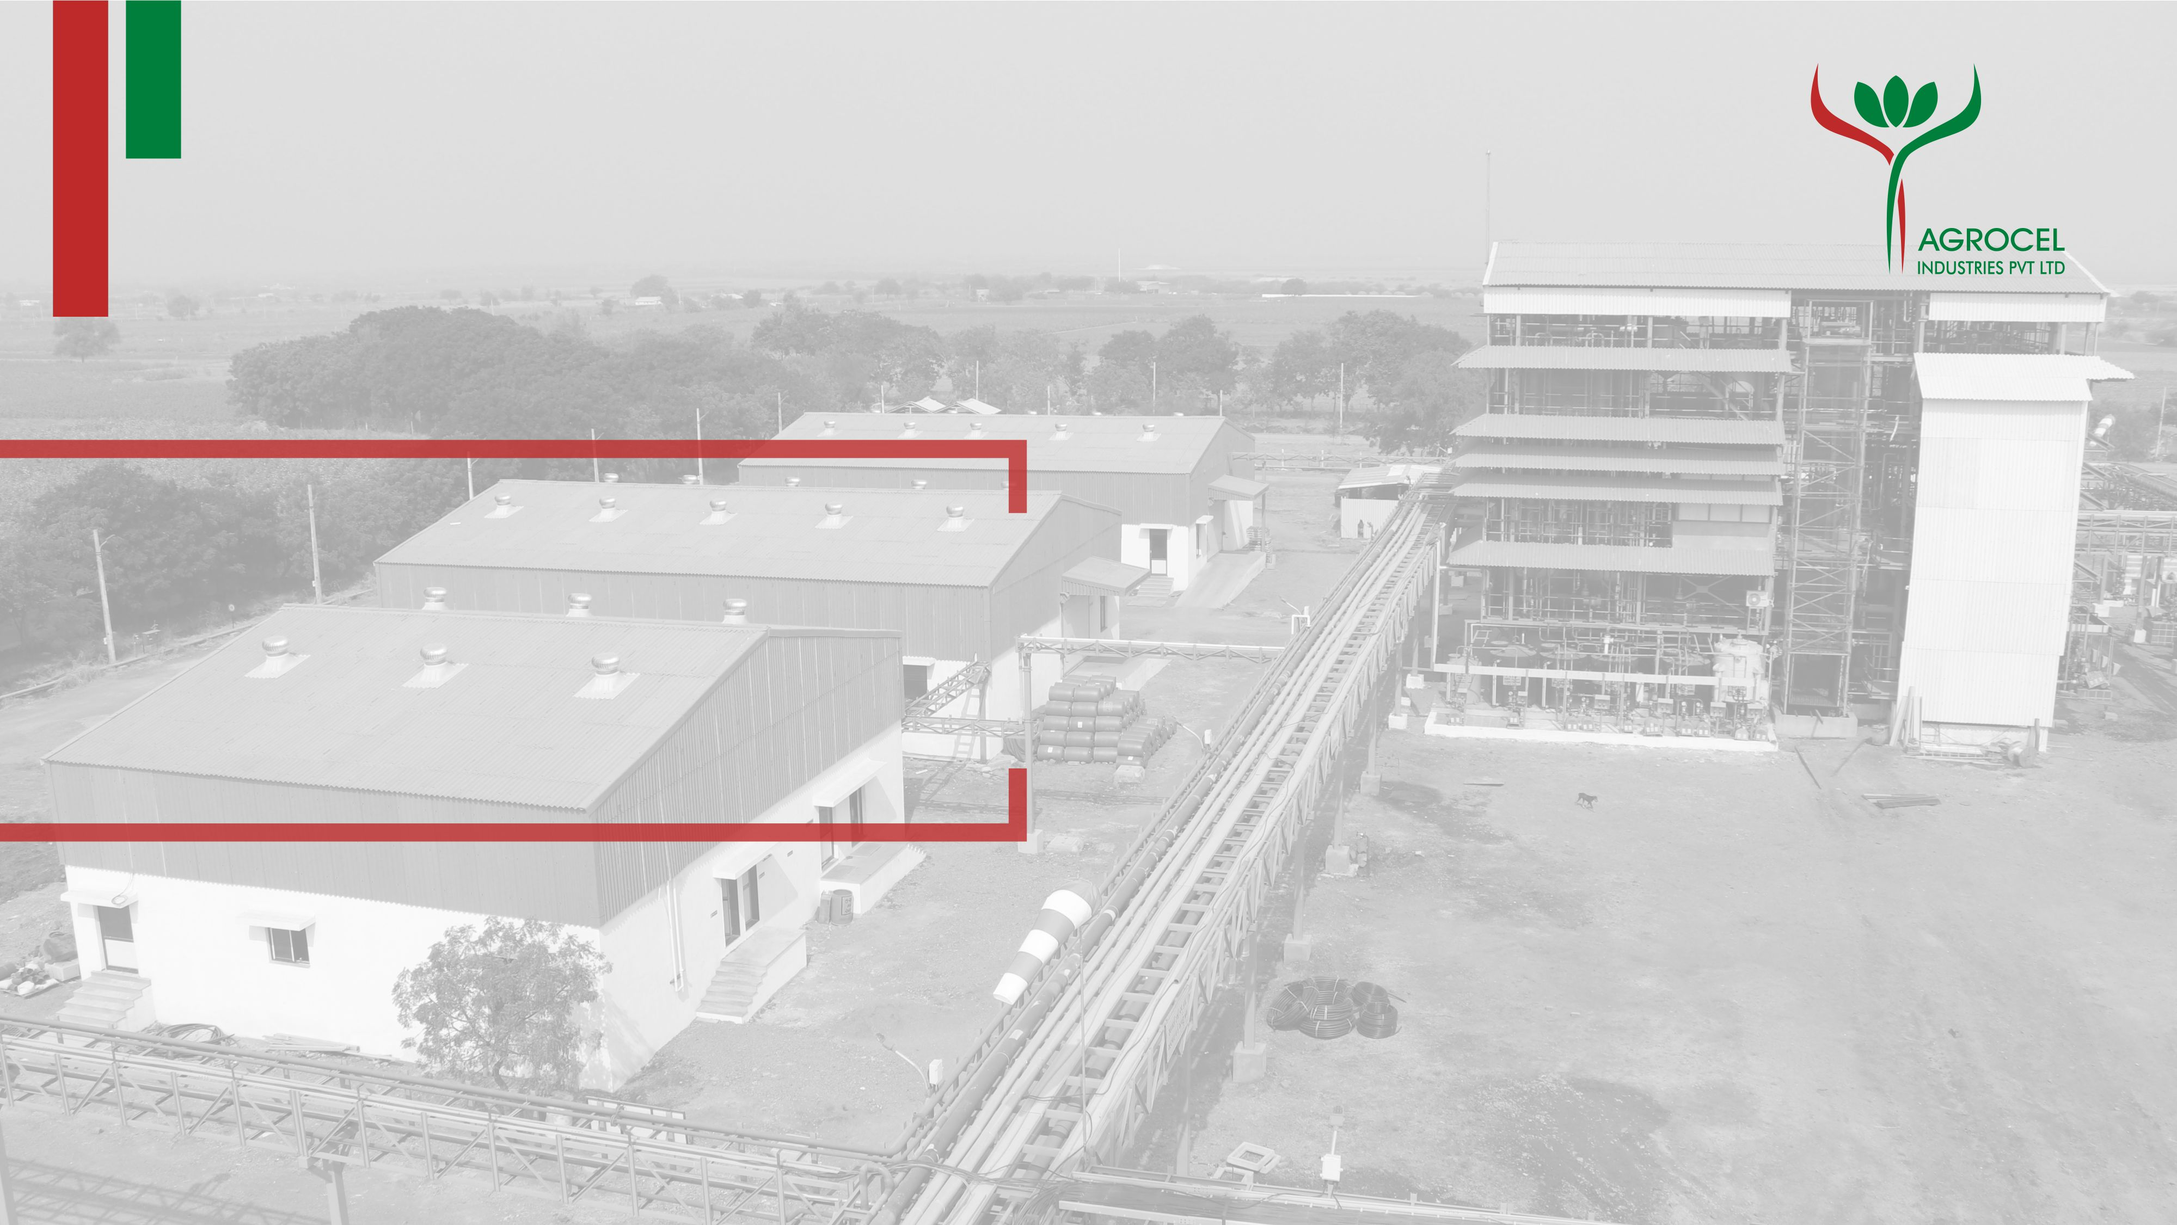
PROCEDURE

Slide 7
Data Collection:
Gather historical data on sulphur prices from industry.
Collect supplementary data that may impact sulphur prices, such as production volumes, demand trends, economic indicators, and geopolitical events.
Data Pre-processing:
Cleanse the data to remove outliers, missing values, and inconsistencies.
Perform exploratory data analysis (EDA) to identify patterns, correlations, and trends in the data.
3.Model Selection:
Choose appropriate machine learning or statistical models for sulphur price prediction, considering factors such as data characteristics, prediction horizon, and interpretability.

Slide 8
4.Model Training
Split the data into training, validation, and test sets.
Train the selected models using the training data and tune hyper parameters using the validation set to optimize performance.
5.Model Evaluation:
Evaluate the performance of trained models using appropriate evaluation metrics.

Slide 9
DATA SOURCES

Slide 10
INTERNAL DATA | EXTERNAL DATA | DURATION
AGROCEL PURCHASE DATA OF SULPHUR GRANULES(Sharada Ma’am) | CRUDE OIL IMPORT IN INDIA (DGFT Website) | April 2021-Nov 2023
AGROCEL PURCHASE DATA OF SULPHURIC ACID (Sharada Ma’am) | CRUDE OIL PRICE IN INDIA (Petroleum Planning and Analysis cell) | April 2021-Nov 2023
 | CRUDE OIL PROCESSED BY RELIANCE AND NAYARA (Petroleum Planning and Analysis cell) | April 2021-Nov 2023
 | ELEMENTAL SULPHUR IMPORT IN INDIA (DGFT Website) | April 2021-Nov 2023
 | WEATHER DATA (Visual Crossing) | April 2021-Nov 2023
 | EXCHANGE RATE DATA (Investing.com India) | April 2021-Nov 2023

Slide 11

SULPHUR MARKET ANALYSIS

Slide 12
Market Analysis
Around 68 million tonnes of sulphur are produced annually
Around 36 million tonnes of sulphur are traded annually (53%)
The Middle East accounts for over 40% of exports.
Around 99% is a by-product of oil and gas production and refining
Eastern Asia and Africa each account for more than 10 million tonnes of imports.
Data Source : https://www.spglobal.com/commodityinsights/en

Slide 13
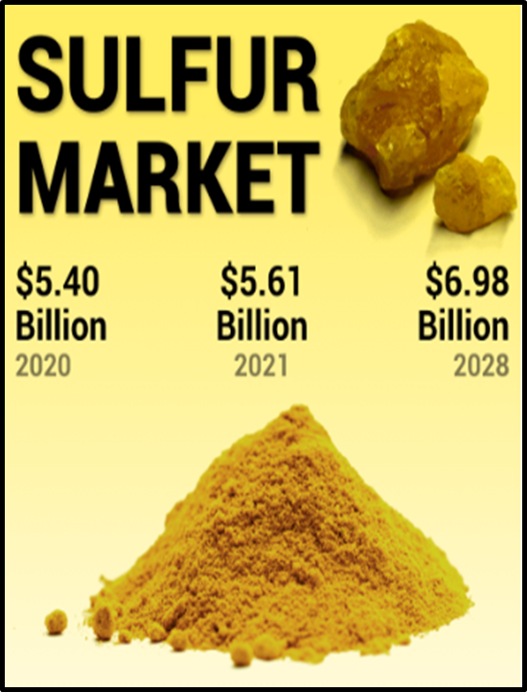
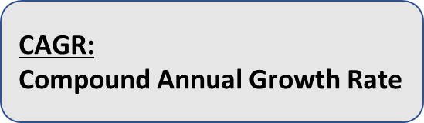
Global Sulphur Market
The global sulphur market is projected to grow in terms of value from $5.61 billion in 2021 to $6.98 billion in 2028 at a CAGR of 4.73%
The sulphur market is expected to grow in terms of quantity from 77.30 million metric tons in 2023 to 97.41 million metric tons by 2028.
Asia-Pacific dominated the global market, with the largest consumption in terms of volume and value.
Data Source : https://www.mordorintelligence.com/

Slide 14
Asia-Pacific Sulphur Market
The Asia Pacific sulphur market size was valued at USD 4.00 billion in 2022 and is estimated to reach around USD 5.51 billion by 2032, growing at a CAGR of 3.30% from 2023 to 2032.
As per the National Bureau of Statistics of China, the production of sulfuric acid reached record highs in 2022 at 95.05 million metric tons, registering a growth of 1.3% from the output achieved in 2021.
In terms of production, India produced 320.76 lakh metric tons of fertilizers during April-mid December of FY 2022-23, which contributed to a comfortable availability of fertilizers as per the Ministry of Chemicals and Fertilizers.
India is one of the largest producers and consumers of rubber after China in the Asia-Pacific region. India has about 6000 manufacturing units comprising 30 large-scale manufacturing units, 300 medium manufacturing scale, and around 5,600 small-scale and tiny sector manufacturing units. thus generating a substantial demand for sulphur
About one-third of total global rubber consumption is natural rubber produced in plantations in Thailand, Indonesia, and Malaysia. Thailand is one of the largest producers and exporters of natural rubber global.
Data Source : https://www.mordorintelligence.com/

Slide 15
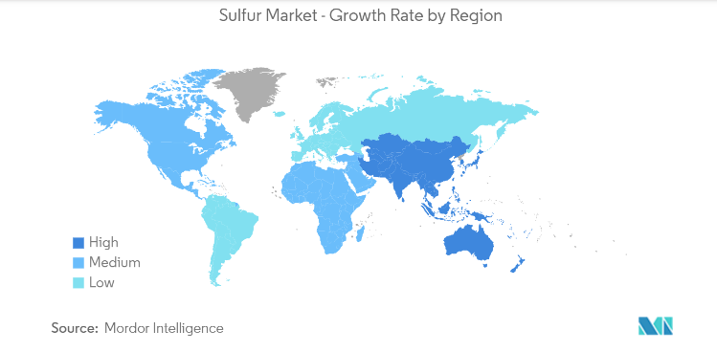
High growth rate of Sulphur in Asia-Pacific Region
Data Source : https://www.mordorintelligence.com/

Slide 16
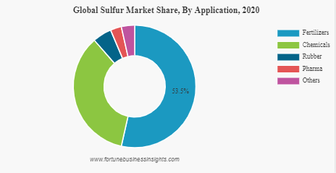
Major Driving Industries
More than 50% of the sulphur is constituted by the fertilizer industries.
Followed by Chemical industries which mainly include Sulphuric Acid manufacturing industries.
Data Source : https://www.fortunebusinessinsights.com/

Slide 17
EXPLORATORY DATA ANALYSIS

Slide 18
AGROCEL SULPHUR PURCHASE AND CONSUMPTION ANALYSIS

Slide 19
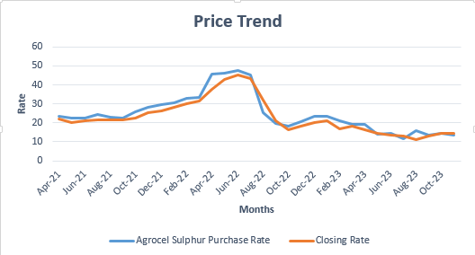
Agrocel Sulphur Purchase Price Trend
The average purchase rate of sulphur granules are:
A sudden notable surge in the purchase rate of sulphur in year 2022.
The purchase rate consistently exceeds the closing price.
2021 | 2022 | 2023
24.68 | 32.75 | 16.40
Data Source : Agrocel data sorted

Slide 20
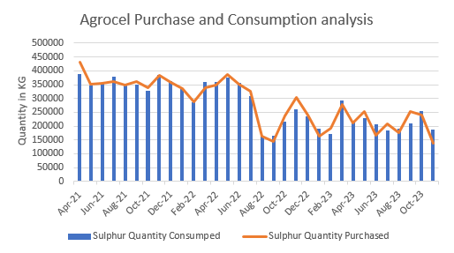
Agrocel Sulphur Purchase and Consumption Analysis
Agrocel’s Storage Licence : 100Ton
The is no periodicity or seasonality in the sulphur consumption by company.
Over the year there appears to be a steady decline in consumption.
Quantity Purchase is made in accordance with the consumption quantity.
Data Source : Agrocel data sorted

Slide 21
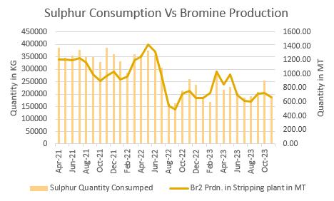
Analysis of Sulphur Consumption and Bromine production
This suggests the correlation between the reduction in bromine production and a subsequent decline in sulphur consumption.
Data Source : BRS plant Production data

Slide 22
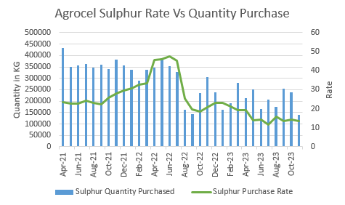
Agrocel Sulphur Rate and Quantity Purchase Analysis
Bulk purchases of sulphur has no influence on the price of sulphur.
Sulphur prices tend to be driven more by broader market forces rather than individual purchase volumes.
Data Source : Agrocel data sorted

Slide 23
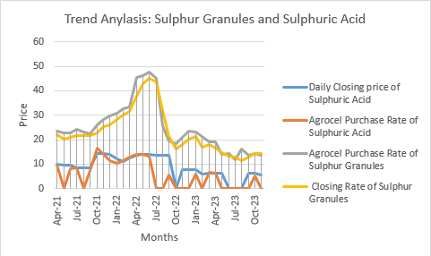
Correlation Between Agrocel Sulphur Purchase Rate and Agrocel Sulphuric Acid Purchase Rate
Graphs indicates strong correlation between sulphur and sulphuric acid price.
The lack of significant price hype in sulphuric acid compared to sulphur can be attributed to the higher number of suppliers for sulphuric acid as opposed to sulphur.
Shows the similar trend of rising rate in this time frame.
Data Source : Agrocel Sulphuric Acid

Slide 24
AGROCEL SULPHUR PURCHASE RATE CORRELATION WITH EXTERNAL FACTOR

Slide 25
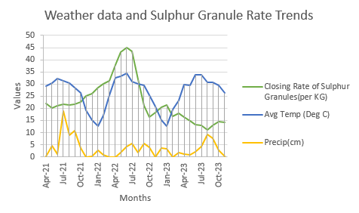
Agrocel Sulphur Purchase Rate correlation with External Factor
Weather Data(Monthly)
No correlation between sulphur price and weather data is evident.
Data Source : https://www.visualcrossing.com/

Slide 26
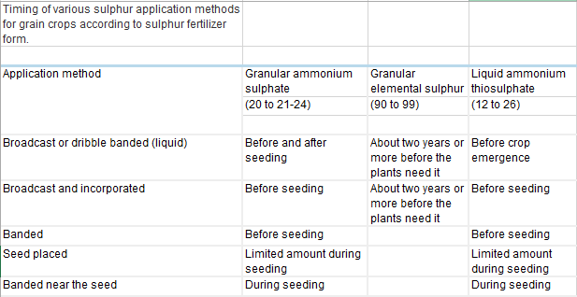
Timing and Method of Usage of Sulphur Fertilizer
Data Source : https://www.sulphurinstitute.org/

Slide 27
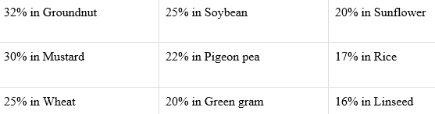
Sulphur applications on sulphur deficient soils
Increase crop yield by:
Wheat, Mustard, Pigeon Pea, Green gram, linseed are Rabi Crops
Rice, Soybean, Groundnut are Kharif Crops
Based on the above two chart we can inferred that the application of sulphur fertilizer is not tied to specific season.
Usage of sulphur dependent on soil type and nutrient content in soil.
Data Source : https://www.sulphurinstitute.org/

Slide 28

Sulphur Deficiencies at Country Level
Soil fertility surveys by the ICAR system (analysis of 60,000 soil samples) have shown sulphur deficiencies to be a widespread problem. A soil is considered deficient in S if it tests less than 10 mg S/kg soil extractable with 0.15% CaCl₂.
Based on reported results, out of over 49,000 soil samples analysed across 18 states,
46% of samples were deficient in sulphur
30% were medium in available sulphur which could be considered as potentially sulphur deficient
These data prove that sulphur deficiencies are a critical problem in 40-45% of districts translating into 57-64 million ha of net sown area.
A = 45% districts having more than 40% soil samples deficient in S
B = 40% districts having 20-40% soil samples deficient in S
C = 15% districts having less than 20% soil samples deficient in S
Data Source : https://www.sulphurinstitute.org/

Slide 29
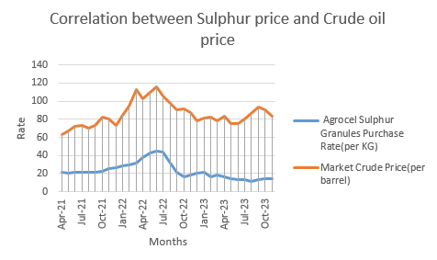
Crude Oil Price in the Indian Market
Illustrates the robust correlation between the crude oil prices and sulphur price.
Strong correlation as it shows similar trend.
Note:
Rate of crude oil is in Dollar and Rate of sulphur is in Rupees
Data Source :https://www.dgft.gov.in/

Slide 30
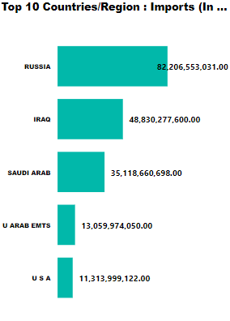
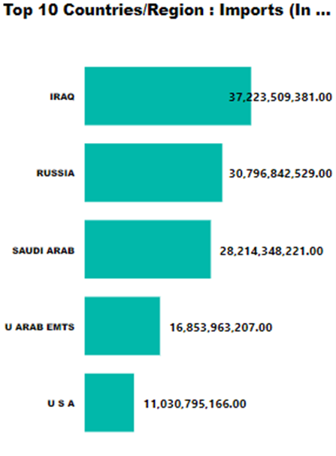
Crude Oil Imports in the Indian Market
2023
2022
Data Source :https://www.dgft.gov.in/

Slide 31
Organisation of the Petroleum Exporting Countries (OPEC), mainly in the Middle East and Africa, made up for as much as 90% of all crude oil India imported at one point of time, but this has been sliding since Russian oil became available at a discount in the aftermath of Moscow's invasion of Ukraine in February, 2022.
The annual share of OPEC's oil in India's crude imports fell to its lowest level ever in 2023 while that of discounted Russian barrels surged to an all-time high.
Imports of Russian oil accounted for about 36% of India's total crude purchases in 2023 at 1.66 million bpd, the data showed. In 2022, India imported an average 651,800 bpd Russian oil, the data shows. Discounted Russian oil also curtailed India's intake of Middle Eastern oil to the lowest level ever
The average cost of Russian crude including freight costs landing on Indian shores in April 2023 was $68.21 a barrel — the lowest level since the Ukraine war. The average cost of Saudi Arabian crude sent to India in April was $86.96 a barrel, while Iraqi oil was priced at $77.77 a barrel.
Data Source : https://www.thehindu.com/news/national/indias-import-of-russian-oil-scales-new-high-in-may/article66930404.ece

Slide 32
Grade of crude oil Imported by India
Russia: Russia produces sour crude oil from various regions, including Western Siberia and Ural. Urals Blend is one of the main grades of sour crude oil produced in Russia.
Iraq: Iraq is another major producer of sour crude oil, with vast reserves located mainly in the southern Basra region. Basrah Heavy and Basrah Light are prominent grades produced in Iraq.
Saudi Arabia: Saudi Arabia is one of the largest producers of sour crude oil, with significant reserves located primarily in the Eastern Province. The country's main grades include Arab Heavy and Arab Medium.
United Arab Emirates (UAE): The UAE produces sour crude oil from fields in regions such as Abu Dhabi and Dubai. Murban and Upper Zakum are among the key grades produced in the UAE.
India imports various types of crude oil, but it predominantly relies on importing sour crude oil. Like Basrah Heavy, Omani Blend, Iranian Crudes etc . Reason behind this is their cheaper rate and higher configuration of Indian Refineries.
Data Sources : https://www.reuters.com/

Slide 33
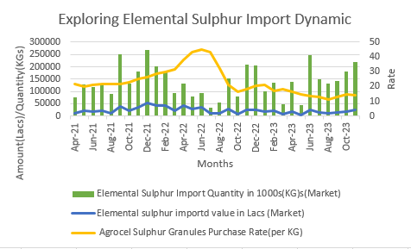
Elemental Sulphur Import
Indicates that the decrease in supply has notable impact on the price.
The period wherein the price increased due to decrease in supply.
Data Source :https://www.dgft.gov.in/

Slide 34
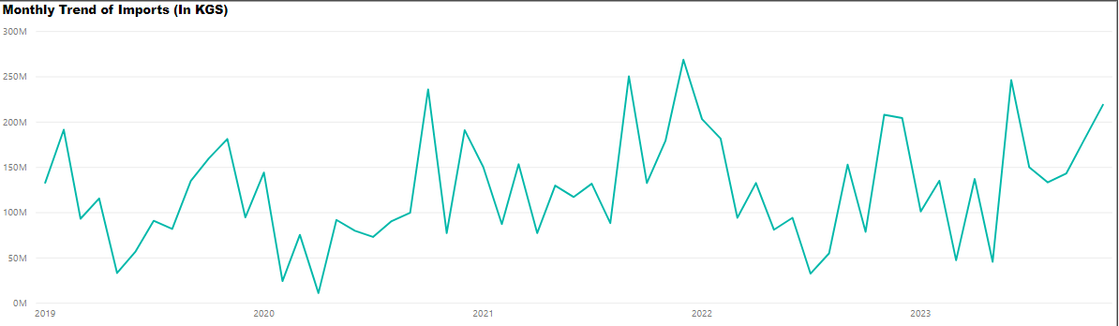
Sulphur Import Trend
The graph illustrating elemental sulphur imports exhibits a noticeable seasonal trend, with a consistent decline in import quantity observed during April- July/August months each year compared to other months.
Data Sources : https://www.dgft.gov.in/

Slide 35
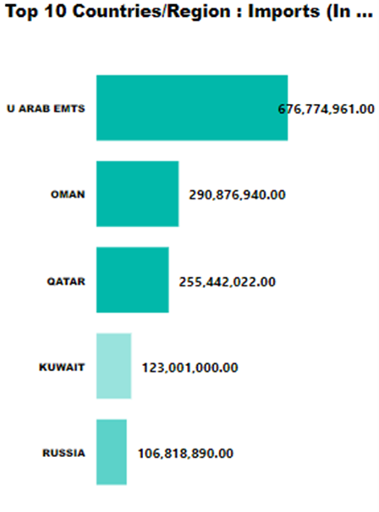
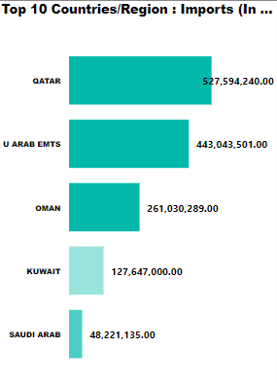
Elemental Sulphur Import in Market
2023
2022
Data Sources : https://www.dgft.gov.in/

Slide 36
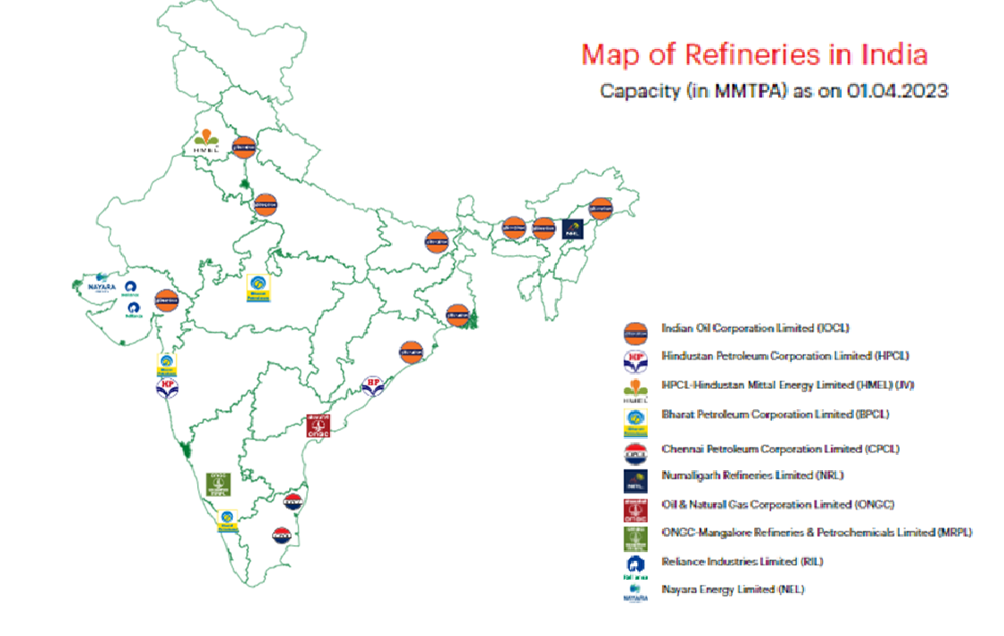
Data Sources : https://www.india.gov.in/official-website-petroleum-planning-and-analysis-cell

Slide 37
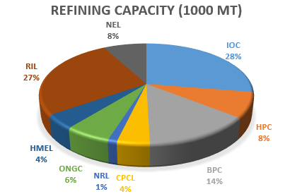
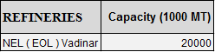
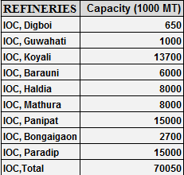
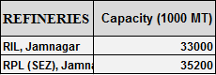
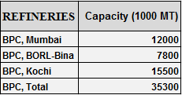
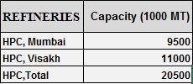
Data Sources : https://www.india.gov.in/official-website-petroleum-planning-and-analysis-cell

Slide 38
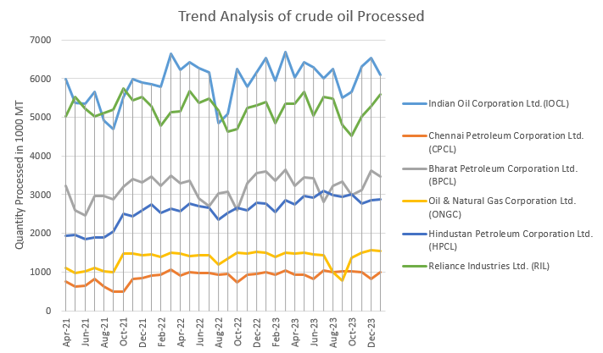
Trend Analysis of crude oil Processed
The data suggests fluctuations in processing volumes without a consistent directional trend.
These fluctuations could be influenced by a various factors including changes in global oil supply, refinery maintenance schedules and market dynamics.
Data Sources : https://www.india.gov.in/official-website-petroleum-planning-and-analysis-cell

Slide 39
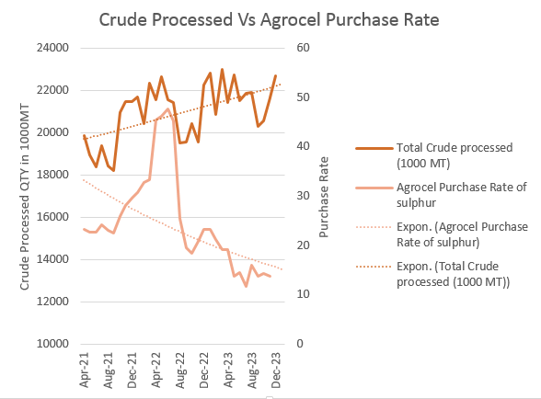
Crude Processed Vs Agrocel Purchase Rate
In the short term, there appears to be no correlation, but over the long term, an inverse relationship becomes evident.
This can be explained by the process where an increase in crude oil processing leads to higher sulfur production, potentially resulting in a decrease in the rate.
Data Sources : https://www.india.gov.in/official-website-petroleum-planning-and-analysis-cell

Slide 40
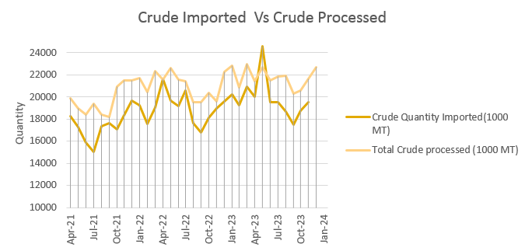
Analysis of Crude Imported and Crude Processed
Crude oil imports directly affect the operations of refineries in India. Refineries adjust their processing volumes based on the availability and cost of imported crude oil.
Mostly similar increase or decrease trend can be seen.
Seasonal fluctuations are evident in the import of crude oil.
In May and June 2023 quantity crude imported surpassed the crude processed.
Data Sources : https://www.india.gov.in/official-website-petroleum-planning-and-analysis-cell

Slide 41
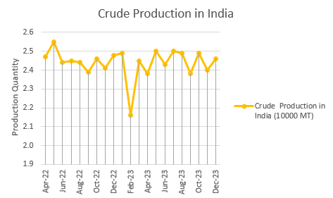
Crude oil Production in India
There was a notable decline in crude oil production during February 2023.
Data Sources : https://www.india.gov.in/official-website-petroleum-planning-and-analysis-cell

Slide 42
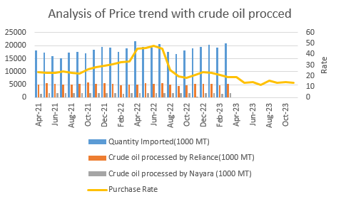
Analysis of Price trend with crude imported and processed by Reliance
Agrocel majorly purchases sulphur from Reliance Industries
Indicates that the Price of Sulphur is not dependent on the quantity of crude oil imported as well as quantity of crude oil processed by Reliance and Nayara
Data Sources : https://www.india.gov.in/official-website-petroleum-planning-and-analysis-cell

Slide 43
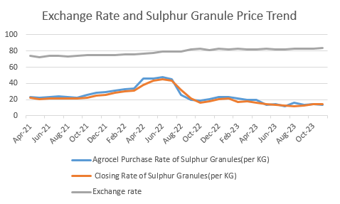
Exchange Rate
Agrocel majorly purchases sulphur from Reliance Industries
The Exchange rate does not influence the Price of Sulphur.
Data Sources : https://in.investing.com/currencies/usd-inr-historical-data

Slide 44
Insights obtain from Exploratory Data Analysis
Crude Oil Prices Influence Sulphur Costs
The close relationship between sulphur and crude oil prices highlights the significant impact of oil market dynamics on sulphur pricing. Since sulphur is often a by-product of oil refining, fluctuations in crude oil prices directly affect the economics of sulphur production.
Elemental Sulphur Imports Impact Domestic Prices
Variations in import volumes influence the balance between local supply and demand, thus affecting price levels.

Slide 45
FEATURE ANALYSIS

Slide 46
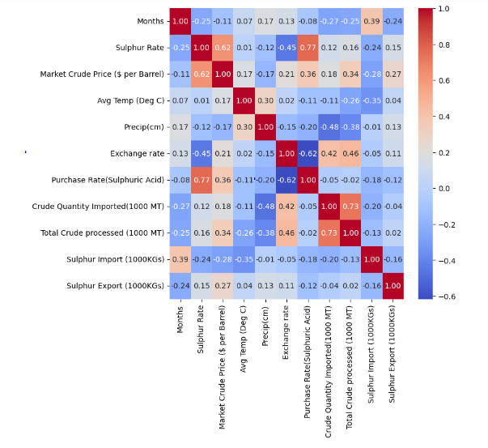
Correlation using Heat map

Slide 47
A heatmap has been created to illustrate the correlations among the features within the dataset.
The intensity of the shade indicates the strength of the correlation, with darker shades(red) representing a stronger correlation, while blue shades signify an inverse relationship.
Notably, there exists a significant positive correlation between the prices of sulphur and sulphuric acid.(i.e 0.77)
Additionally, a strong positive correlation is evident between the rates of sulphur and crude oil prices.(i.e 0.62)
Conversely, an inverse correlation is observed between the rate of sulphur and the amount of sulphur imported.(i.e -0.24)

Slide 48
MODEL SELECTION AND MODEL FITTING

Slide 49
Fitting Machine Learning Models to Monthly Data
The independent or the predictors features are Sulphuric acid rate, Crude oil rate, Temperature, Precipitation, Exchange rate, Quantity crude imported, Quantity crude processed, Sulphur imported, Sulphur exported.
The dependent or the target feature is Sulphur Rate.
To analyse the continuous nature of the data, regression models from machine learning were employed.
Five regression models were tested: Linear Regression, Polynomial Regression, Random Forest, AdaBoost, and XGBoost.
Linear Regression: A simple linear model that assumes a linear relationship between the input features and the target variable. It finds the best-fitting straight line through the data points.
Polynomial Regression: An extension of linear regression that captures non-linear relationships by fitting a polynomial equation to the data.

Slide 50
Random Forest: A versatile ensemble learning method that builds multiple decision trees and combines their predictions to improve accuracy and prevent overfitting.
AdaBoost: An ensemble learning technique that combines multiple weak learners (typically decision trees) to create a strong classifier. It assigns higher weights to misclassified data points to iteratively improve performance.
XGBoost: An advanced implementation of gradient boosting that is known for its efficiency and performance. It builds an ensemble of weak learners sequentially, with each new learner correcting the errors made by the previous ones.

Slide 51
Fitting Time Series Models to Daily Data
In addition to monthly data analysis, I utilized daily data, which is well-suited for time series analysis. As the monthly data has less entries.
ARIMA and VAR models were applied to the daily dataset.
ARIMA (AutoRegressive Integrated Moving Average): A popular time series forecasting model that incorporates autoregression, differencing, and moving averages to capture temporal dependencies and trends in the data. It's particularly effective for stationary time series data.
VAR (Vector Autoregression): Another time series model used for multivariate forecasting, where multiple time series variables are modelled simultaneously. VAR captures dependencies between variables by representing each variable as a linear function of its lagged values as well as the lagged values of other variables in the system.
In VAR model, I used two features that are Sulphur Rate and Sulphuric Acid Rate.

Slide 52
RESULTS

Slide 53
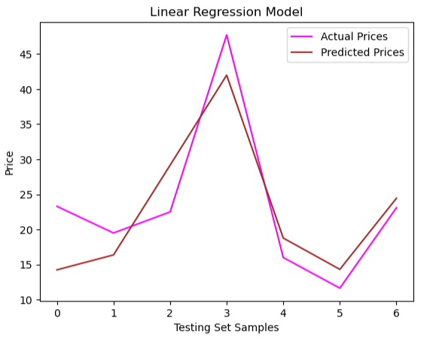
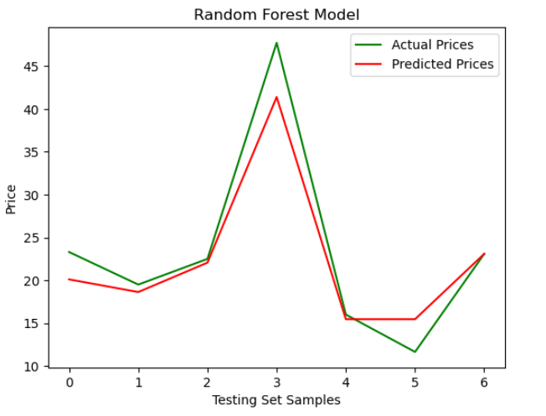
Comparing Actual and Predicted Values Across Various Machine Learning Models

Slide 54
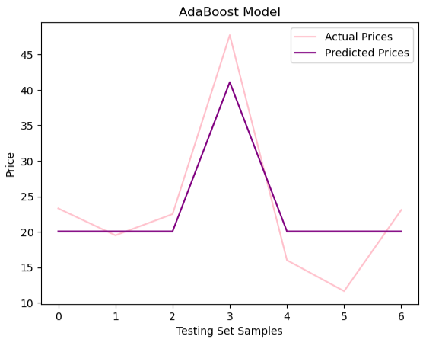
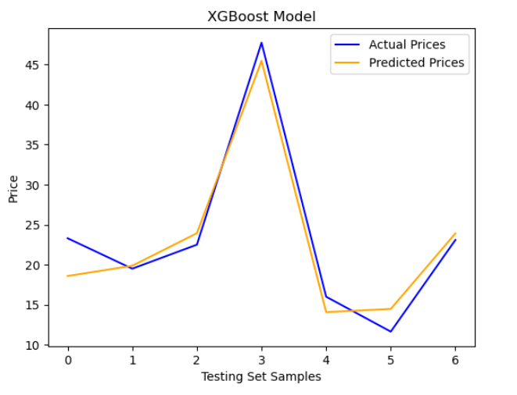

Slide 55
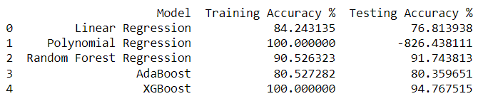
r.
Training and Testing Accuracy of various Machine Learning Model
The training and testing accuracies are determined using the R2 metric.
These accuracies aid in identifying the best-fit model for the data.
Upon analysis, it is observed that Random Forest and XGBoost exhibit the highest accuracies.
However, to select the optimal model, We look at how much the training and testing accuracies differ.
Random Forest emerges as the best-fitted model due to its minimal disparity between the training and testing accuracies.

Slide 56
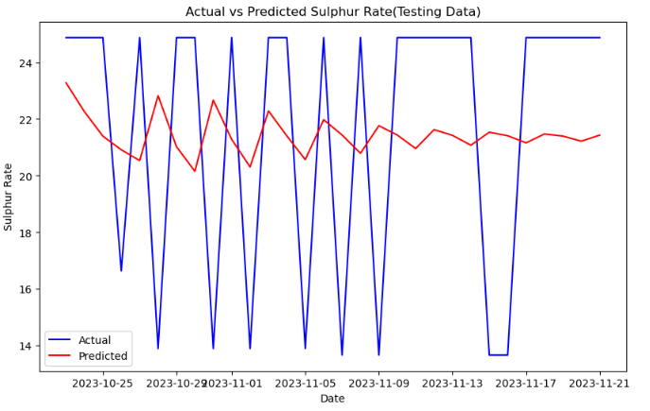
Forecasting Using Time Series Models on Daily Data
Actual values and Predicted values of Testing data

Slide 57
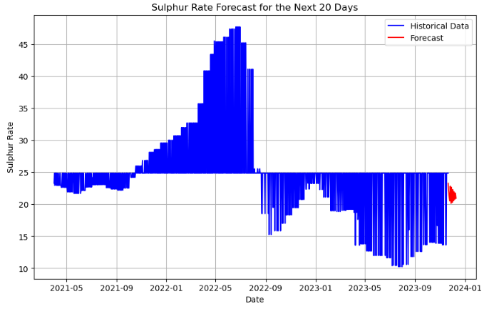
Next 20 Days Forecast

Slide 58
Accuracy of Time series Model (ARIMA)
The RMSE (Root Mean Squared Error) is relatively low (in my case, 5.6), indicating that the model's predictions are close to the actual values on average.
But the R-squared is negative which suggests that model is not much feasible , the following could be the reasons:
One common reason for a negative R^2 score is overfitting, where the model captures noise in the data rather than the underlying patterns
ARIMA models may struggle to capture seasonal patterns in the data, especially if the seasonality is complex or irregular.

Slide 59
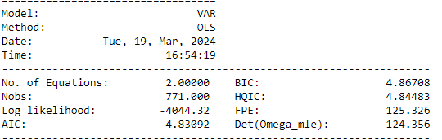
Accuracy of Time series Model (VAR)
Low AIC and BIC values suggest that the VAR model provides a good balance between model complexity and fit to the data.

Slide 60
CONCLUSION

Slide 61
Based on the conclusions drawn from the exploratory data analysis (EDA) and model accuracy observations, the following conclusions can be summarized:
Dependency and Influence of Factors:
The analysis revealed that sulphur price is largely dependent on crude oil price and inversely dependent on sulphur import in the market. These relationships were confirmed through correlation matrices, indicating strong correlations between sulphur price and crude oil price, as well as an inverse correlation between sulphur price and sulphur import.
Additionally, a bidirectional influence was observed between sulphur price and sulfuric acid price, suggesting that changes in one variable affect the other.
Model Performance:
The observed model accuracy suggests that Random Forest performs well on monthly sulphur price data. This indicates that machine learning algorithms, such as Random Forest, can effectively capture the complex relationships present in the data.
However, it was noted that time series models may require regularization techniques to improve accuracy. Regularization methods, such as Ridge regression or Lasso regression, can help mitigate overfitting and enhance the performance of time series models.

Slide 62
Recommendations for Improvement:
To further improve the accuracy of sulphur price prediction models, increasing the amount of available data and incorporating additional relevant features, such as demand for sulphur in different sectors, is recommended. This would provide a more comprehensive understanding of the factors influencing sulphur prices and enable more accurate predictions.
By including additional features related to sulphur demand in various industries, the models can better capture the underlying dynamics of sulphur price fluctuations and provide more accurate forecasts .
.

Slide 63
THANK YOU

